Slide 1
MSc Program
Portfolio Sold-Out Problem in Numbers
for DeFi Lending Protocols
Student: Waralak Pariwatphan
Research Advisor: Yury Yanovich
October, 2023
1/32

Slide 2










Background : DeFi Meets Classic Finance
Securitization
Tokenization
Banks
Group of assets
Marketable securities
Packages
Plenty of intermediaries between bank and investors
Lack of transparency
Regulatory and legal risk
Plenty of intermediaries between bank and investors
Lack of transparency
Regulatory and legal risk
Solve
Blockchain
Classic Finance
DeFi
2/32

Slide 3





Problem
Packages : A
Packages : B
Remaining tokens
How to construct as many packages as possible for a given token set under the specific risk?
or
Tokenization 1
Tokenization 2
Portfolio sold-out problem
3/32

Slide 4

Objectives
01
02
To design and develop optimization methods for obtaining the optimal portfolio sold-out in the following cases:
continuous independent.
continuous general.
discrete independent.
discrete general.
To apply optimization methods to the MakerDAO dataset
4/32

Slide 5

Main Contributions
Implemented tokenization on dataset
03
Formulated and proved Theorem 2
→ optimal numerical solutions
01
02
Proved market concentration
as a reliable metric
Formulated and proved Theorem 3
→ NP-hard problem
04
5/32

Slide 6

Portfolio sold-out problem: An overview
Problem
similar to
Markowitz model
Different
Instead of seeking a single best portfolio, construct as many reasonably good portfolios as possible.
small investors
One of subproblem is related to SOCP → optimal solution
One of subproblem is related to Subset Sum Problem → NP₋hard
6/32

Slide 7
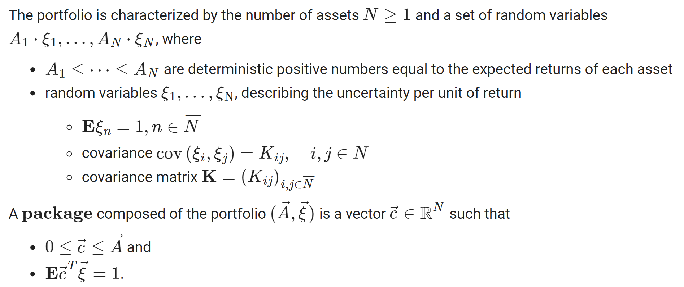
Methodology
7/32

Slide 8
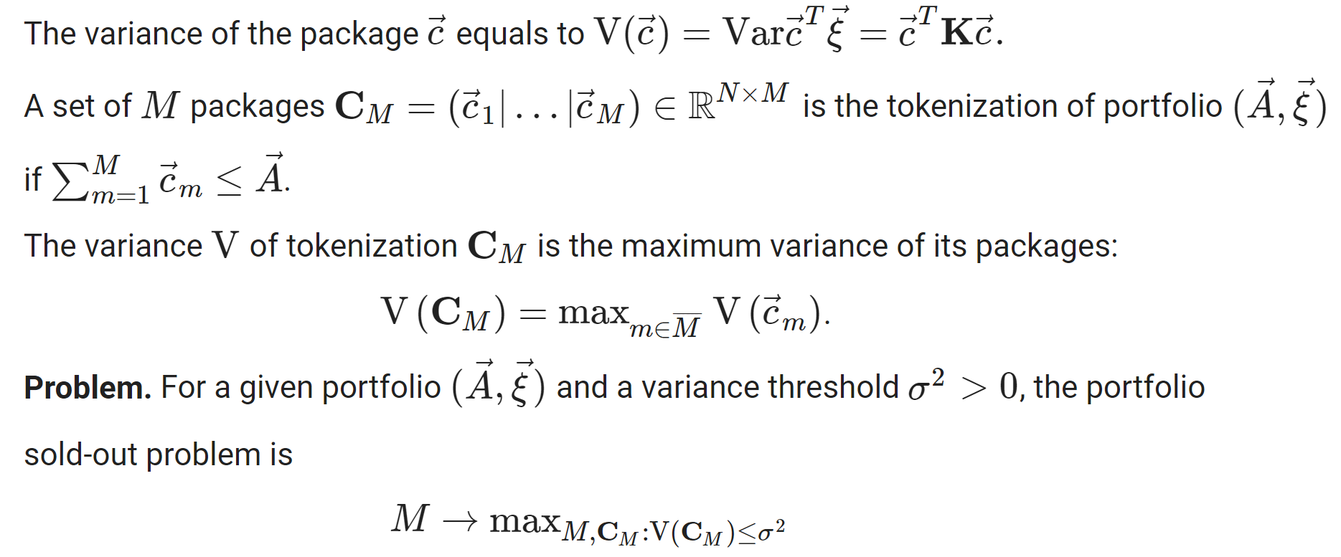
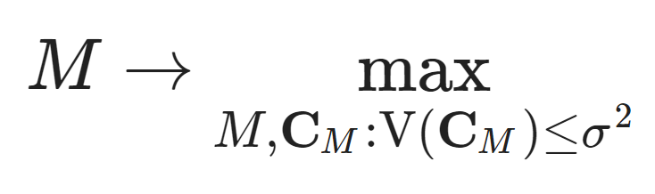
Methodology
8/32

Slide 9
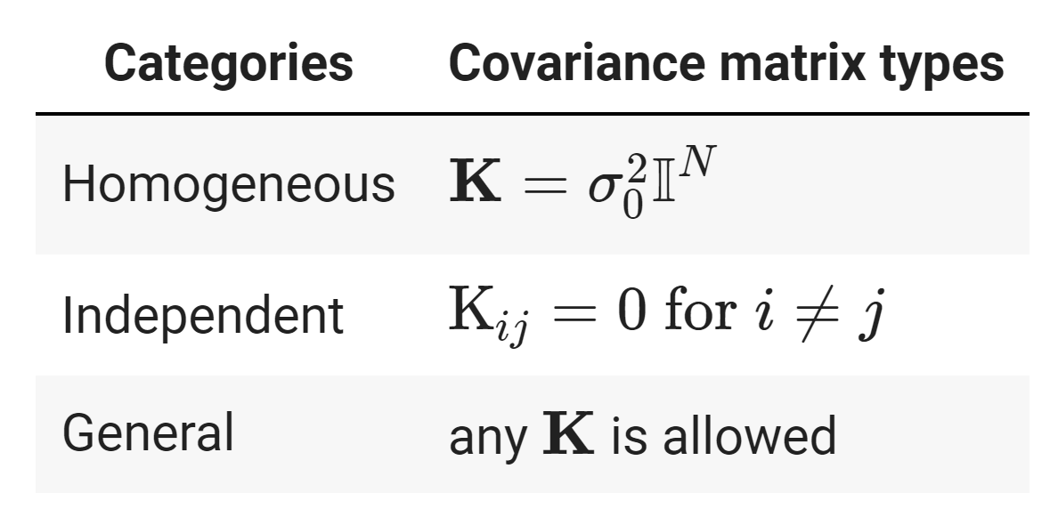
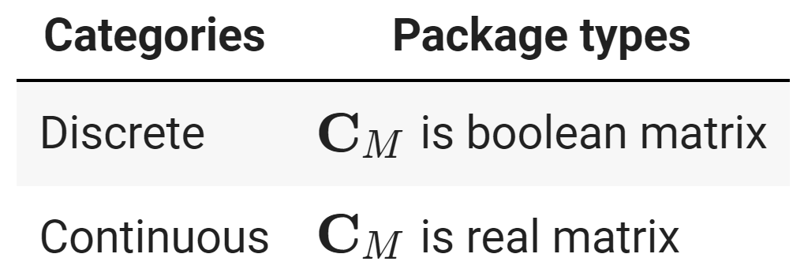
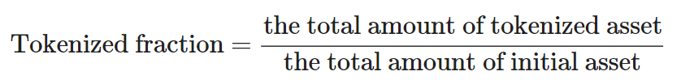
Methodology : Portfolio sold-out special cases
By assets:
 | Discrete | Continuous
Homogeneous | optimal solution | optimal solution
Independent | to be solved | to be solved
General | to be solved | numerical solution
By packages:
The proportion of tokenized asset into the packages defines as
9/32

Slide 10




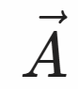


Methodology : Dataset
Initial debt
Normal repayment
Borrower
Normal case
Return 1,000 DAI + 20 DAI (interest)
Return collateral 1 ETH
Daily data
A is borrowers with debt amounts.
K is a covariance for their defaults.
Borrow 1,000 DAI
Collateral 1 ETH ($2,000)
Liquidation
ETH price drops
1 ETH = $1,400
Collateral ratio < 1.5
1,000 (loan) + 20 (interest) + 133 (penalty)
Collateral auction 1 ETH
Liquidation case
MakerDAO
Return remaining 0.176 ETH
MakerDAO loan system
10/32

Slide 11
Results : Portfolio sold-out problem
 | Discrete | Continuous
Homogeneous | optimal explicit solution | optimal explicit solution
Independent | to be solved | to be solved
General | to be solved | numerical solution
 | Discrete | Continuous
Homogeneous | optimal explicit solution | optimal explicit solution
Independent | NPH | optimal numerical solution
General | NPH | optimal numerical solution
Solutions for portfolio sold-out special cases
Results | 01 Theorem-Continuous | 02 Theorem-Discrete | 03 Apply Data-Continuous General | 04 Apply Data-Discrete General | 05 Discussion
11/32

Slide 12
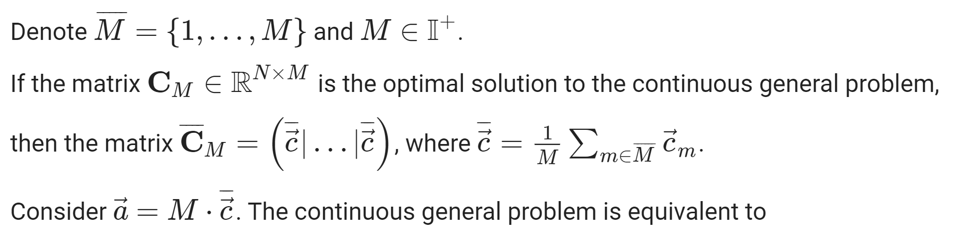
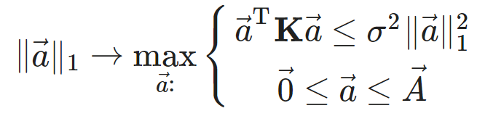
Result : Continuous General Case
Theorem 2. Portfolio sold-out problem is polynomial reducible to second order cone programming.
→ optimal numerical solution.
CP
SDP
LP: linear program,
QP: quadratic program,
SOCP second-order cone program,
SDP: semidefinite program,
CP: cone program.
SOCP
QP
Proof.
LP
Results | 01 Theorem-Continuous | 02 Theorem-Discrete | 03 Apply Data-Continuous General | 04 Apply Data-Discrete General | 05 Discussion
12/32

Slide 13
Result : Continuous Independent and General Cases
less complex
 | Discrete | Continuous
Homogeneous | optimal explicit solution | optimal explicit solution
Independent | to be solved | to be solved
General | to be solved | optimal numerical solution
 | Discrete | Continuous
Homogeneous | optimal explicit solution | optimal explicit solution
Independent | to be solved | optimal numerical solution
General | to be solved | optimal numerical solution
Results | 01 Theorem-Continuous | 02 Theorem-Discrete | 03 Apply Data-Continuous General | 04 Apply Data-Discrete General | 05 Discussion
13/32

Slide 14
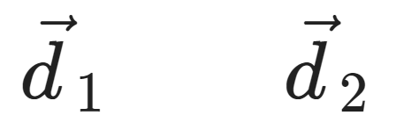
Results : Discrete Case Algorithm
Subset Sum Problem
Generate all possible vectors of assets allocated into portfolio
A
A
1 | 1 | 1
1 | 1 | 0
1 | 0 | 1
0 | 1 | 1
B
1 | 1
B
C
1
C
Initial assets (N=3)
Given the number of chosen assets (k) = 2
All possible vectors ₃C₂ = 3
Keep only vectors that variance ≤ σ²
1
1
0
1
0
1
3
2
1
1
1
0
Integer Programming
1
0
1
1 +1 ≤
,
Number of packages (M) = 2
All allowed vectors
Results | 01 Theorem-Continuous | 02 Theorem-Discrete | 03 Apply Data-Continuous General | 04 Apply Data-Discrete General | 05 Discussion
14/32

Slide 15
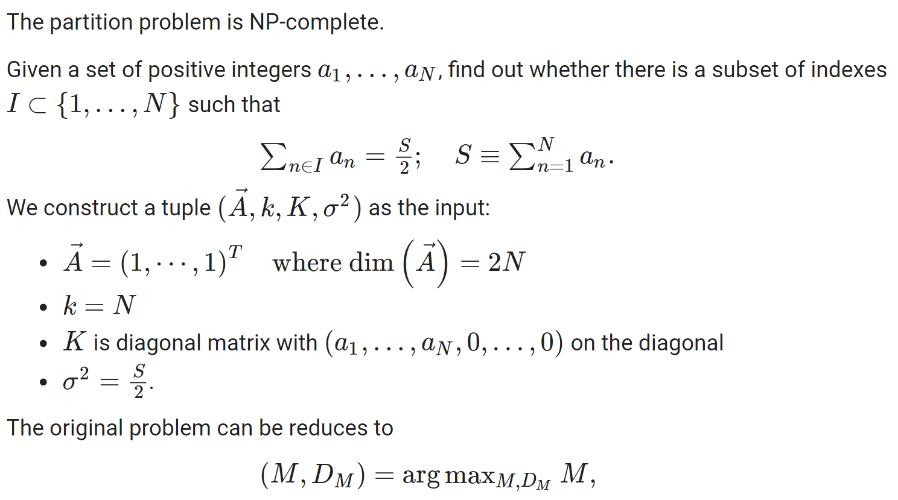
Results : Discrete Independent Case
Theorem 3. Discrete independent optimal portfolio sold-out problem is NP-Hard.
Proof.
Results | 01 Theorem-Continuous | 02 Theorem-Discrete | 03 Apply Data-Continuous General | 04 Apply Data-Discrete General | 05 Discussion
15/32

Slide 16
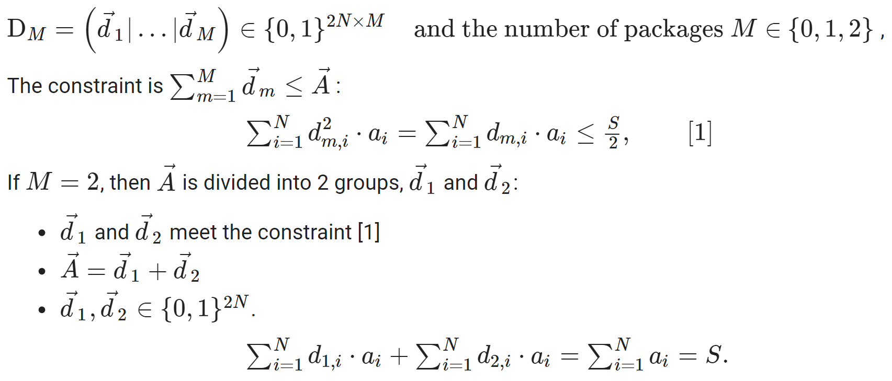
Results : Discrete Independent Case
Results | 01 Theorem-Continuous | 02 Theorem-Discrete | 03 Apply Data-Continuous General | 04 Apply Data-Discrete General | 05 Discussion
16/32

Slide 17
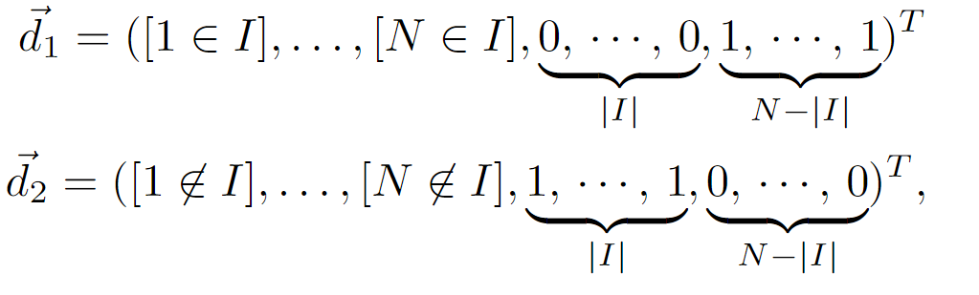
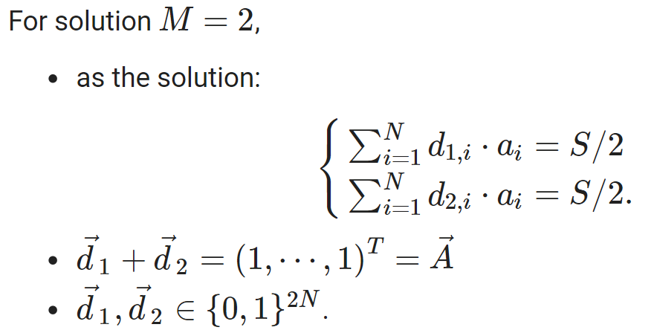
Results : Discrete Independent Case
For example, given a solution subset of indexes I ⊂ {1, . . . , N}, we can construct
Results | 01 Theorem-Continuous | 02 Theorem-Discrete | 03 Apply Data-Continuous General | 04 Apply Data-Discrete General | 05 Discussion
17/32

Slide 18
Result : Discrete Independent and General Cases
more complex
 | Discrete | Continuous
Homogeneous | optimal explicit solution | optimal explicit solution
Independent | NPH | optimal numerical solution
General | to be solved | optimal numerical solution
 | Discrete | Continuous
Homogeneous | optimal explicit solution | optimal explicit solution
Independent | NPH | optimal numerical solution
General | NPH | optimal numerical solution
Results | 01 Theorem-Continuous | 02 Theorem-Discrete | 03 Apply Data-Continuous General | 04 Apply Data-Discrete General | 05 Discussion
18/32

Slide 19
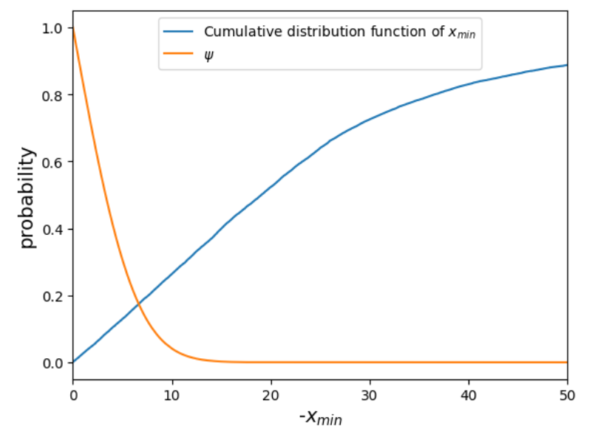
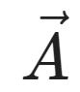
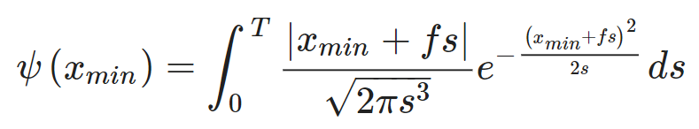
Results : MakerDAO dataset
Daily data
A is borrowers with debt amounts.
K is a covariance for their defaults.
General case: Any K is allowed
Probability of default
Probability and level of default
Results | 01 Theorem-Continuous | 02 Theorem-Discrete | 03-04 Apply Data-General Cases |  | 05 Discussion
19/32

Slide 20
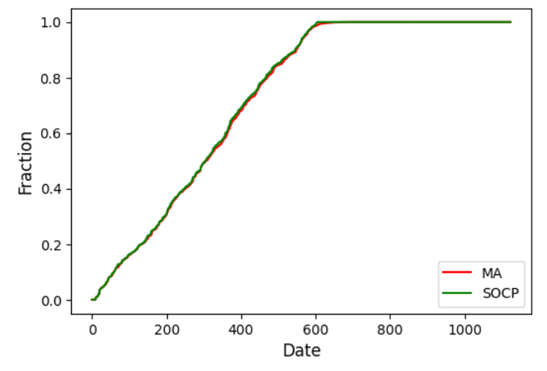
Result : Continuous General Case
Method | Tokenized Fraction
Baseline : Metaheuristic Algorithm (MEALPY) | 65.20 %
Second Order Cone Program (CVXPY) | 65.69 %
Tokenized fractions of the continuous general case with different optimization methods
Sorted tokenized fractions for continuous general case
Results | 01 Theorem-Continuous | 02 Theorem-Discrete | 03 Apply Data-Continuous General | 04 Apply Data-Discrete General | 05 Discussion
20/32

Slide 21
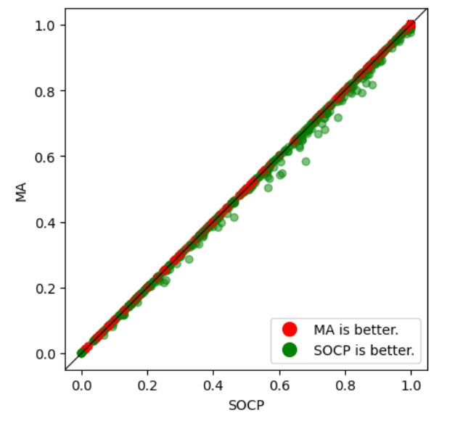
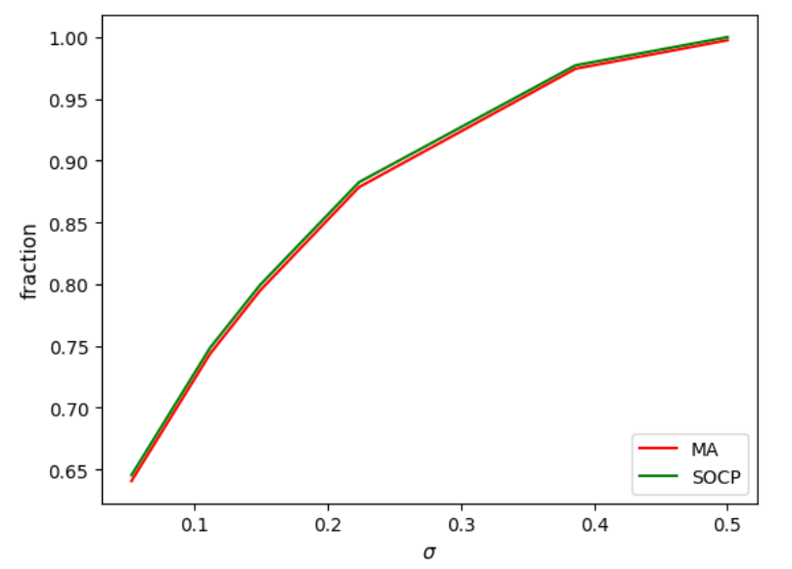
Result : Continuous General Case
Comparing tokenized fractions with different optimization methods
Comparing tokenized fractions with different levels of σ
Results | 01 Theorem-Continuous | 02 Theorem-Discrete | 03 Apply Data-Continuous General | 04 Apply Data-Discrete General | 05 Discussion
21/32

Slide 22
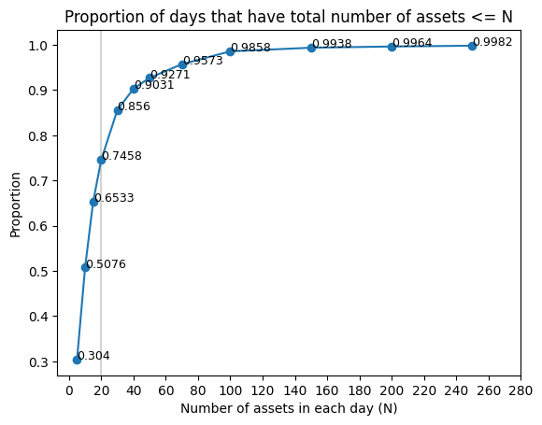
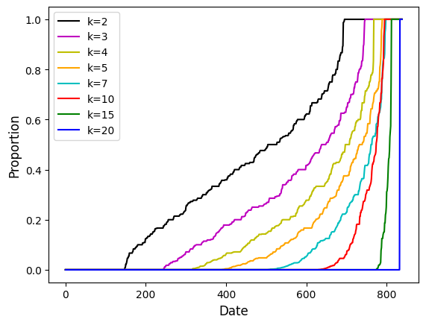
Results : Discrete General Case
The proportion of data that have less than or equal to N assets to the total amount of data.
The proportion of the number of allowed vectors to the total number of possible vectors.
Results | 01 Theorem-Continuous | 02 Theorem-Discrete | 03 Apply Data-Continuous General | 04 Apply Data-Discrete General | 05 Discussion
22/32

Slide 23
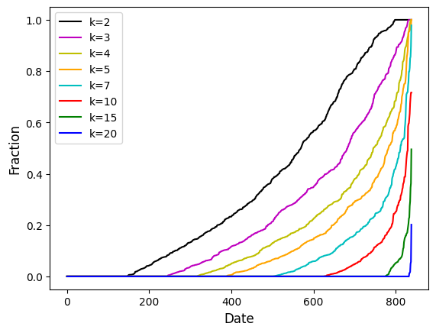
Results : Discrete General Case
The number of chosen assets (k) | Tokenized Fraction
k=2 | 28.03 %
k=3 | 20.40 %
k=4 | 14.93 %
k=5 | 11.73 %
k=7 | 7.17 %
k=10 | 3.45 %
k=15 | 0.78 %
k=20 | 0.04 %
Tokenized fractions of the discrete general case vary with the amount of chosen assets
Sorted tokenized fractions for discrete general case
Results | 01 Theorem-Continuous | 02 Theorem-Discrete | 03 Apply Data-Continuous General | 04 Apply Data-Discrete General | 05 Discussion
23/32

Slide 24
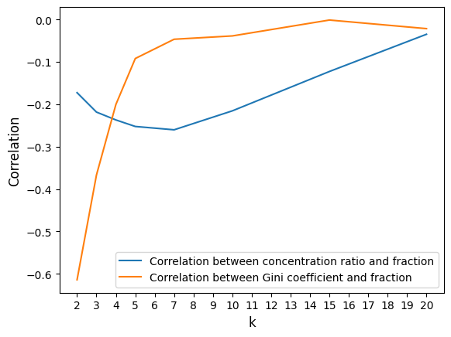
Results : Discrete General Case
Comparing correlation between market concentration and fraction and correlation between Gini coefficient and fraction with different number of chosen assets (k)
Results | 01 Theorem-Continuous | 02 Theorem-Discrete | 03 Apply Data-Continuous General | 04 Apply Data-Discrete General | 05 Discussion
24/32

Slide 25
Discussion
 | Discrete | Continuous
Homogeneous | optimal explicit solution | optimal explicit solution
Independent | NPH | optimal numerical solution
General | NPH | optimal numerical solution
 | Discrete | Continuous
Homogeneous | optimal explicit solution | optimal explicit solution
Independent | to be solved | to be solved
General | to be solved | numerical solution
 | Discrete | Continuous
Homogeneous | optimal explicit solution | optimal explicit solution
Independent | to be solved | optimal numerical solution
General | to be solved | optimal numerical solution
 | Discrete | Continuous
Homogeneous | optimal explicit solution | optimal explicit solution
Independent | NPH | optimal numerical solution
General | NPH | optimal numerical solution
Previous works
Davydov and Yanovich 2020
Chaleenutthawut et al. 2021
SOCP → upper bound
Davidsson 2011
computational complexity
Research limitation: Based on single-collateral type
Results | 01 Theorem-Continuous | 02 Theorem-Discrete | 03 Apply Data-Continuous General | 04 Apply Data-Discrete General | 05 Discussion
25/32

Slide 26
Discussion
 | Discrete | Continuous
Homogeneous | optimal explicit solution | optimal explicit solution
Independent | NPH | optimal numerical solution
General | NPH | optimal numerical solution
 | Discrete | Continuous
Homogeneous | optimal explicit solution | optimal explicit solution
Independent | to be solved | to be solved
General | to be solved | numerical solution
 | Discrete | Continuous
Homogeneous | optimal explicit solution | optimal explicit solution
Independent | to be solved | optimal numerical solution
General | to be solved | optimal numerical solution
 | Discrete | Continuous
Homogeneous | optimal explicit solution | optimal explicit solution
Independent | NPH | optimal numerical solution
General | NPH | optimal numerical solution
Previous works
Davydov and Yanovich 2020
Chaleenutthawut et al. 2021
SOCP → upper bound
Davidsson 2011
computational complexity
Research limitation: Based on single-collateral type
Results | 01 Theorem-Continuous | 02 Theorem-Discrete | 03 Apply Data-Continuous General | 04 Apply Data-Discrete General | 05 Discussion
25/32

Slide 27
Conclusions
Portfolio sold-out problem: – continuous independent case – continuous general case – discrete independent case – discrete general case
Solved by SOCP
NP-hard problem
For continuous cases: SOCP → upper bound comparisons with MA
For discrete cases: – k influences tokenized fractions. – market concentration → slightly impact on tokenized fractions. – Gini coefficient → significantly affects tokenized fractions for small k.
26/32

Slide 28
Scientific novelty
Most researchers prioritize primary market portfolio optimization.
Use blockchain to tokenize loans and create secondary market commodities.
Blockchain offers new competitive advantages.
27/32

Slide 29

Innovation
Emerging ventures, with a focus on DeFi lending protocols.
Financial institutions and banks exploring cutting-edge solutions for loan portfolio management.
28/32

Slide 30
Outcomes
Paper: Currently, we are working on paper for publication.
29/32

Slide 31


Outlook
Research on multi-collateral
Apply tokenization to other datasets
Cooperate with QuickToken.Ltd to make the software product
30/32

Slide 32
Acknowledgements
I would like to express my heartfelt gratitude to Yury Yanovich for the invaluable support and thoughtful suggestions provided.
31/32

Slide 33
Thank you for your attention
Q&A
32/32

